Slide 1

Visualization Of Crime Hotspots Through Analysis Of Online Newspaper Articles
Project Guide:
Dr. M Trupthi
Assistant Professor
IT Department, CBIT
Batch no.109
Neha Dinesh Prabhu - 160117737011
Prerana Rajole -160117737013

Slide 2
AGENDA
Abstract
Introduction
Problem System
Literature Survey
System Requirements
Dataset and algorithms
System Design
Implementation
Testing and Results
Conclusion and Future Scope
References

Slide 3
ABSTRACT
Growth in Indian cities has lead to an exponential increase in the crime rate. Crimes like murder, kidnap, extortion, rape, etc. are a daily occurance.
Since there is no way for people to know how safe a location is, we want to build a model that classifies crimes mentioned in the news articles and extracts information like location and time and use this data to create a visualization which shows how safe a location is.

Slide 4
INTRODUCTION
MOTIVATION
Parents’ concern for the safety of their children outside the house.
Families moving to new places or going on vacation
APPLICATIONS
Real Estate
City Police Station
Citizens Safety

Slide 5
PROBLEM STATEMENT
We aim to build a software that analyses crimes mentioned in the news articles and create a visualization tool which shows how safe a location is.
We will use NER to extract the location and time and classify the crime type and display the number relatively in the form of a heat map.

Slide 6
LITERATURE SURVEY
PAPER TITLE | AUTHOR | ADVANTAGES | DISADVANTAGES
Building an Urban Theft Map by Analyzing Newspaper Crime Reports IEEE 2018 | Laura Po; Federica Rollo | The application extracts basic semantic information about particular thefts from newspaper articles. Extracted data is visualized based on user queries on maps | •No classifier used because aim was just to locate theft
Crime news analysis: Location and story detection IEEE 2018 | Mehedee Hassan; Mohammad Zahidur Rahman | Classifies if a news article as crime related news or not crime related. Uses SVM Also provides the crime location | •No visual aid •ignores entities that can affect the entity recognition

Slide 7
PAPER TITLE | AUTHOR | ADVANTAGES | DISADVANTAGES
A Machine learning Approach to classify Articles based on Location IEEE 2017 | Vignesh Rao; Jayant Sachdev | uses various classifiers such as Naïve Bayes, Support vector Machines and compares accuracy | •SVM has a huge training time •Naïve Bayes cannot recognize new classes
Exploiting Categorization of Online news for Profiling City Areas IEEE 2020 | Alessandro Bondielli; Pietro Ducange; Francesco Marcelloni | Articles of local online newspapers, by exploiting information regarding the text as well as metadata such as tags. | •No customized web-crawler •No automatic extraction

Slide 8
SYSTEM REQUIREMENTS
SOFTWARE REQUIREMENTS
Operating System | Any OS
Programming Language | Python
Platform | Jupyter Notebook/ Google Colab
Important Libraries | Transformers, Torch, Selenium, Geopy.geocoder, Bokeh, etc.
API’s | Google API

Slide 9
SYSTEM REQUIREMENTS
HARDWARE REQUIREMENTS
Processor | Intel CORE i5
RAM | 8 GB
Hard Disk space | 200 GB
GPU | Minimum of 8GB
GPU time comparisons
GPU Model | Tesla T4 | Tesla K80 | Tesla P4
Training Time | 59 minutes | 120 minutes | 93 minutes

Slide 10
SYSTEM DESIGN
web scrape news articles from online sources .
Pre-process the article and feed the sentences into the NER (Named Entity Recognition) model.
The NER model is built by fine-tuning the pre-trained BERT(Bidirectional Encoder Representations from Transformers) model to obtain features such as location of the crime, date and time and crimes type (murder, sexual assault, kidnapping, etc,.)
Save the locations in a dataframe and obtain longitude and latitude using API
Display number of crimes location wise on a heatmap.

Slide 11
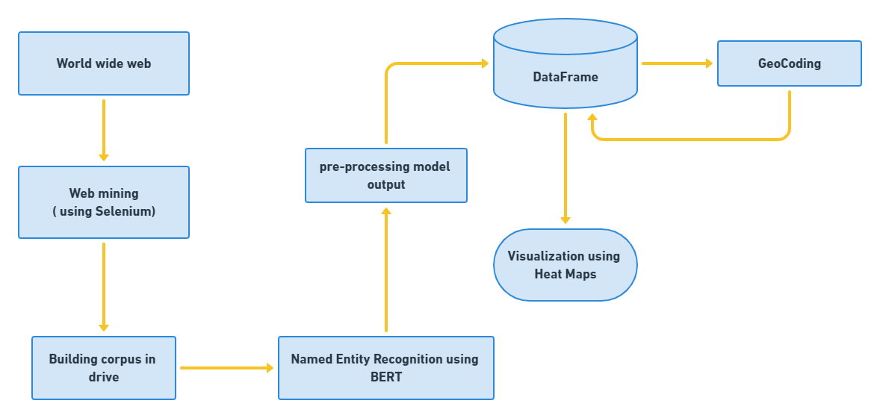
SYSTEM ARCHITECTURE
System Architecture
Notes:
Corpus- collection of texts
Tokenization- Tokenization is breaking the raw text into small chunks. Tokenization breaks the raw text into words, sentences called tokens.
A stop word is a commonly used word (such as “the”, “a”, “an”, “in”) that a search engine has been programmed to ignore, both when indexing entries for searching and when retrieving them as the result of a search query.
Stemming- A stemming algorithm reduces the words “chocolates”, “chocolatey”, “choco” to the root word, “chocolate” and “retrieval”, “retrieved”, “retrieves” reduce to the stem “retrieve”.
Lemma

Slide 12
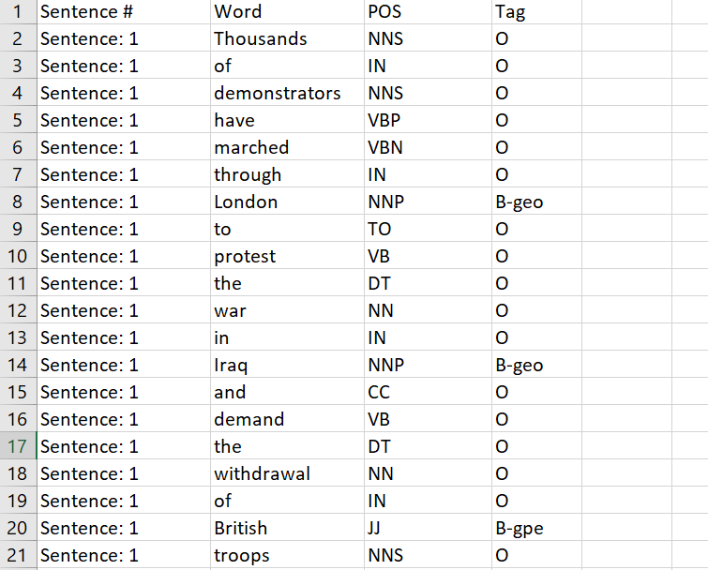
DATASET
We have used a customized dataset which is a collection of news paper articles.
The dataset had 4 columns:
Sentence # - holds the sentence number
Word – holds the word
POS – holds the parts of speech tag for the corresponding word
Tag – contains the BIO tag of the word
Screenshot of dataset

Slide 13
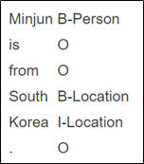
The dataset is labelled according to the BIO scheme. BIO stands for Beginning, Inside and Outside of a sentence segment.
Example of BIO scheme

Slide 14
ALGORITHM
BERT - Bidirectional Encoder Representations from Transformers
It's a Google-developed Transformer-based machine learning technique for natural language processing (NLP) pre-training.
The model is pre-trained on unlabeled data extracted from Wikipedia having 2,500 million words and BooksCorpus having 800 million words.
It is bi-directional and also takes into account the context for each occurrence of a given word.

Slide 15
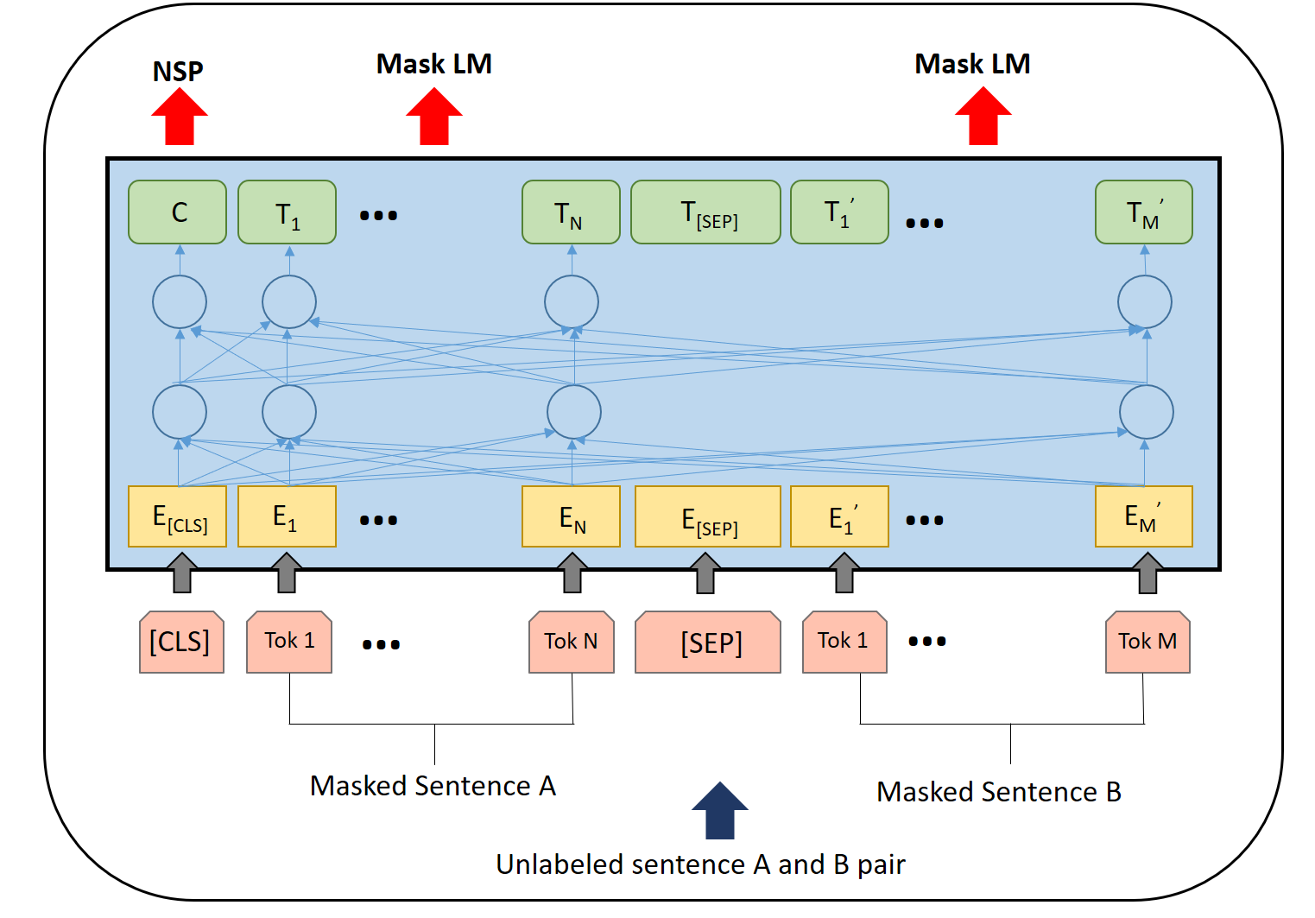
Pre- trained BERT Architecture

Slide 16
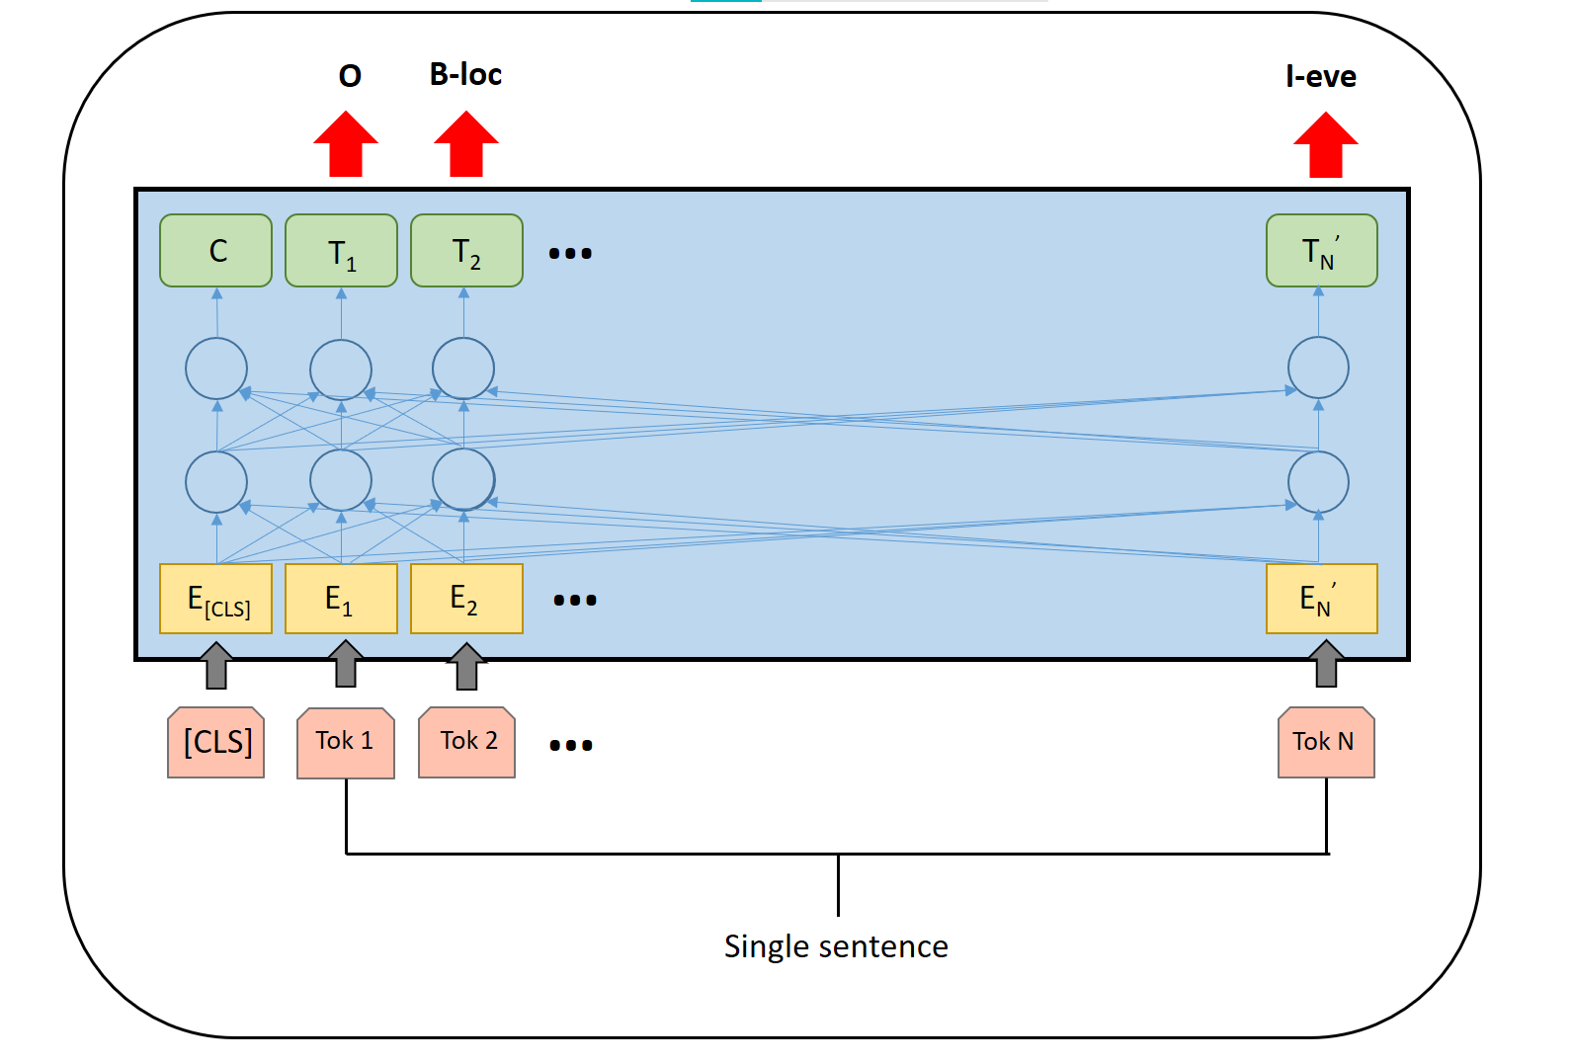
The model can be modified to perform NER tasks by adding a classification layer that will predict the NER label after feeding the output vector of each token to it.
BERT Architecture for NER

Slide 17
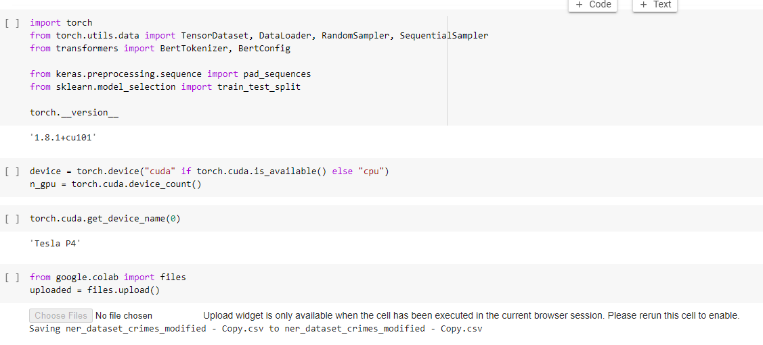
IMPLEMENTATION

Slide 18
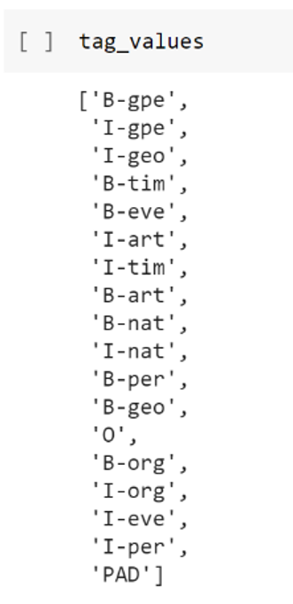
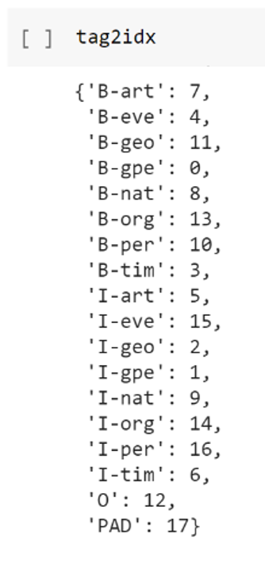
tag_values is a list of all the unique tags that exist in our dataset. The order of the tags should be maintained when the model is used for inference.
tag_values and tag2idx

Slide 19
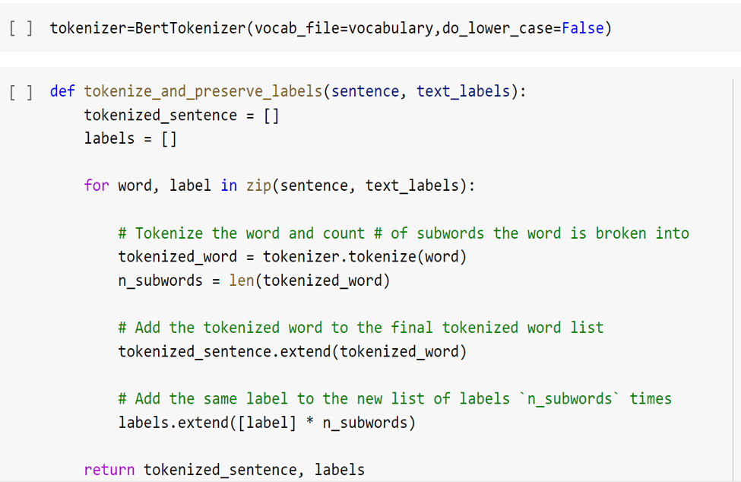
Loading tokenizer and BERT vocabulary

Slide 20
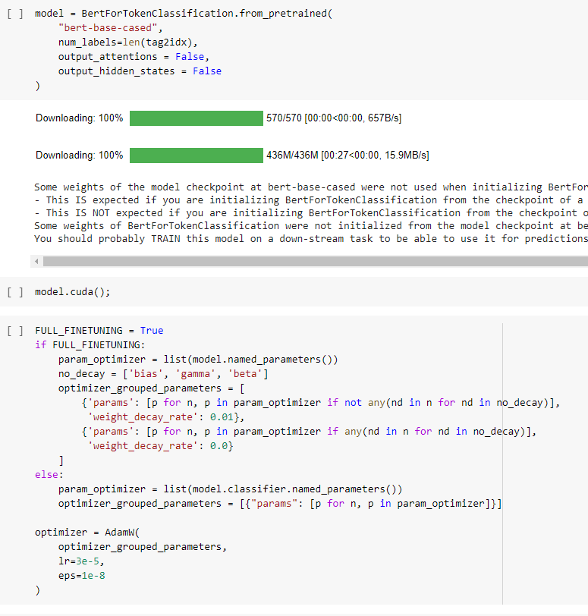
The pre-trained model has 12 layers.
After that weight parameters are separated into the bias, gamma, and beta parameters.
Following the separation, two groups are created – one having these values and the other one without the values. Each of the groups also has a different decay rate 0.0 and 0.01 respectively
Loading pre-trained model and fine-tuning

Slide 21
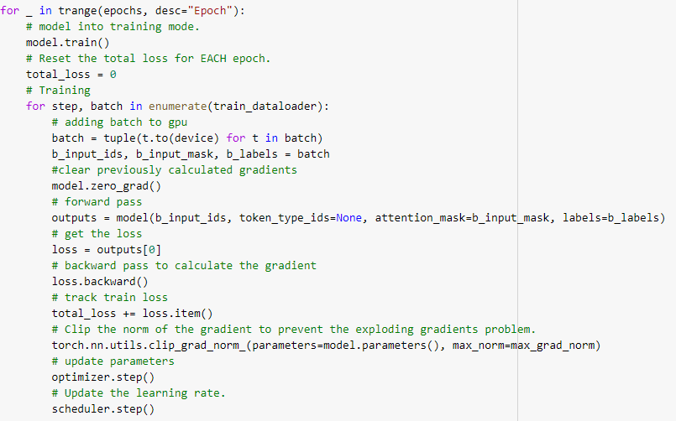
The model uses gradient clipping to deal with the exploding gradient problem.
The main aim of gradient clipping is to rescale the gradient if it becomes too large.
Training the model

Slide 22
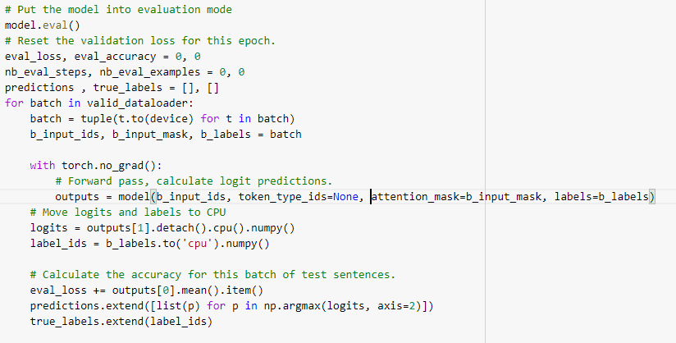
Evaluating the model

Slide 23
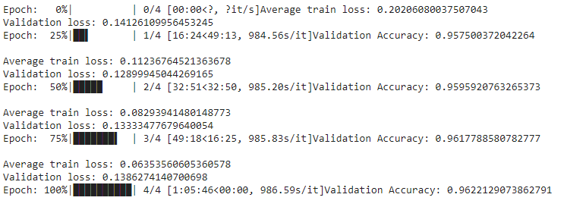
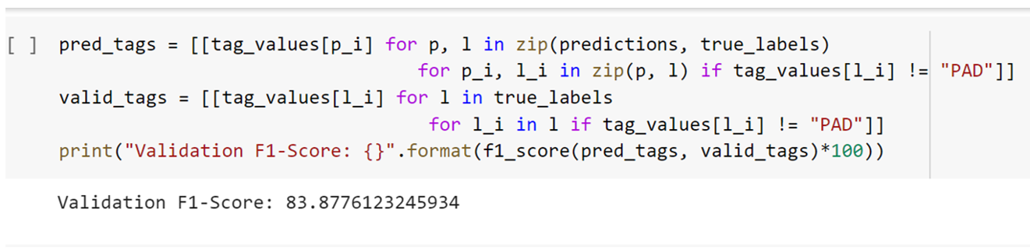
Evaluation of the model

Slide 24
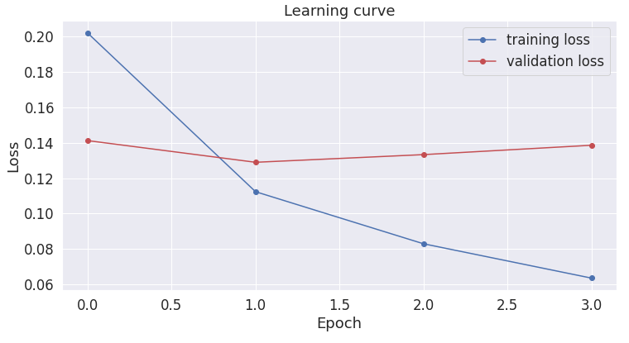
Learning Curve
The learning curve is plotted between the loss and epoch number. Our aim is to make sure that both the loss has the least difference with the training loss to be the lesser value

Slide 25
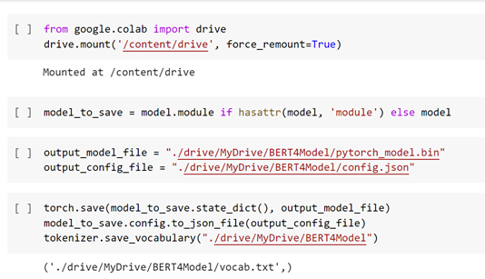
Saving the model in the drive

Slide 26
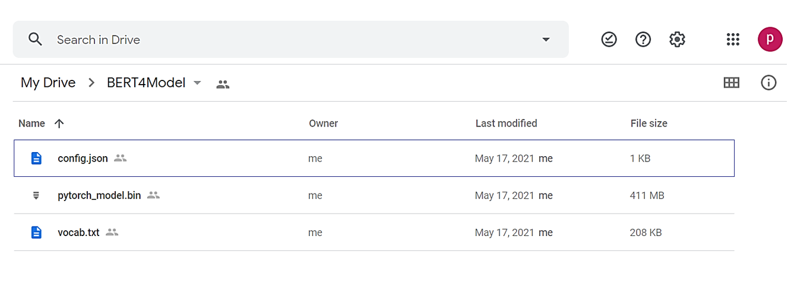
Folder containing trained model and weights
The model is the file with the .bin extension and has a size of 411 MB. The configuration of the model is saved in the config.json file and has all the weights after fine-tuning the model.

Slide 27
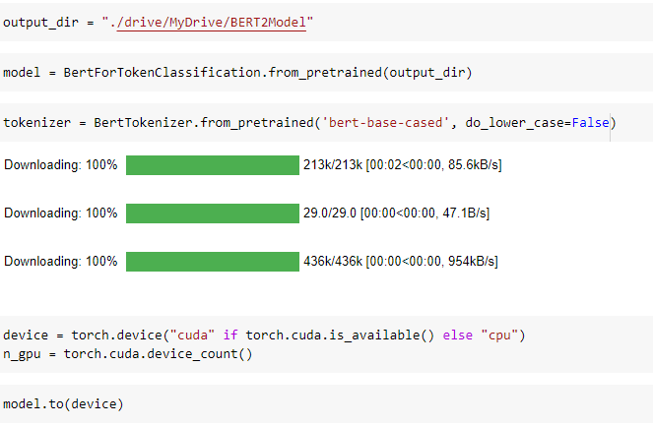
TESTING
Loading the saved model and tokenizer

Slide 28
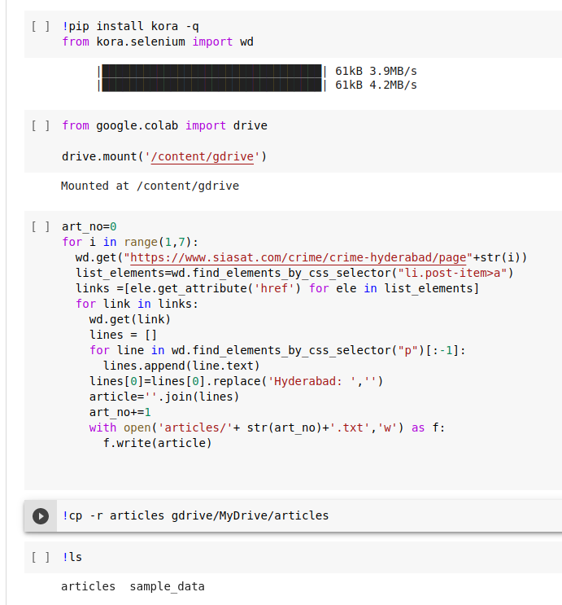
Web-scraping the news articles

Slide 29
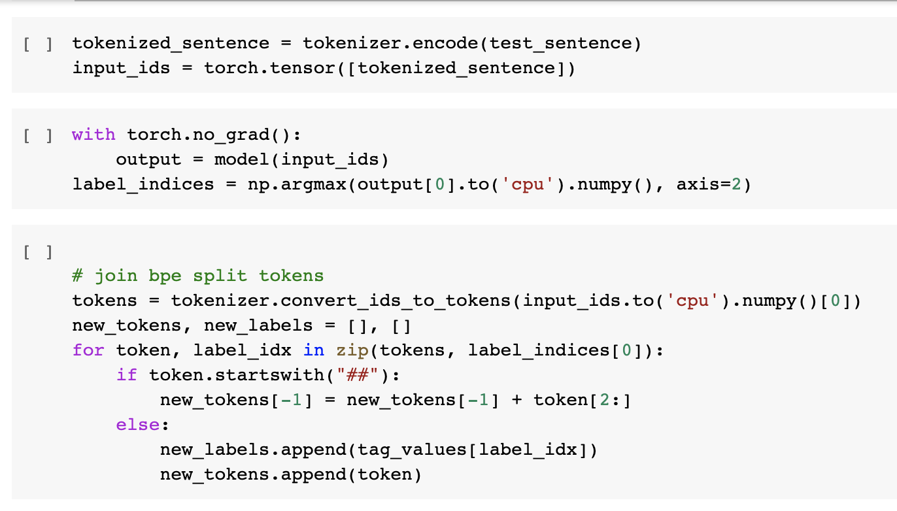
Pre-processing the input for the model
Bert Vocabulary is set to 30K tokens. Subwords and characters are used to represent words that are not in the lexicon.

Slide 30
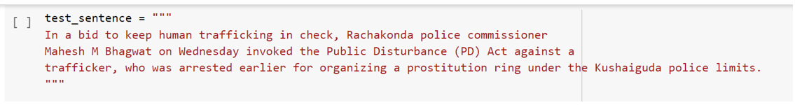
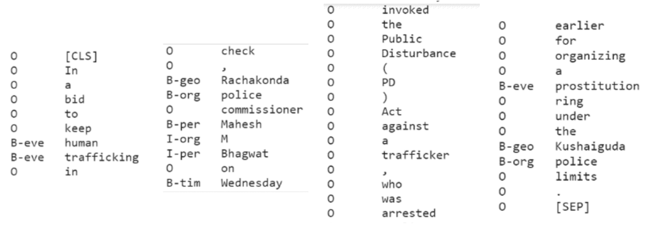
Input (1)
Output for input (1)

Slide 31
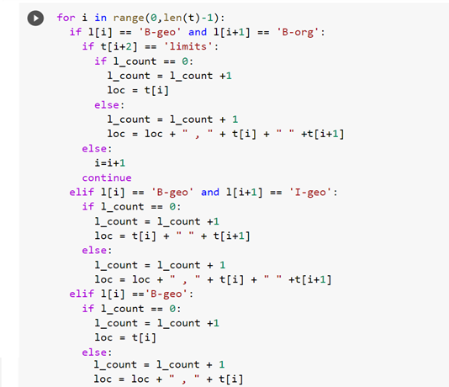
Pre-processing the input for the model

Slide 32
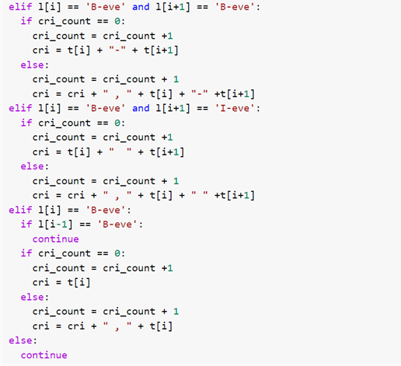
Pre-processing the input for the model

Slide 33
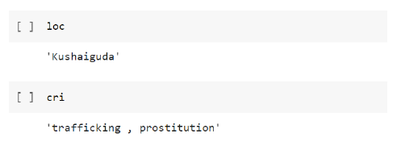
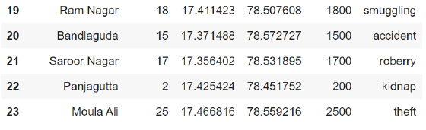
Processed output for input (1)
Screenshot before inserting input (1)

Slide 34
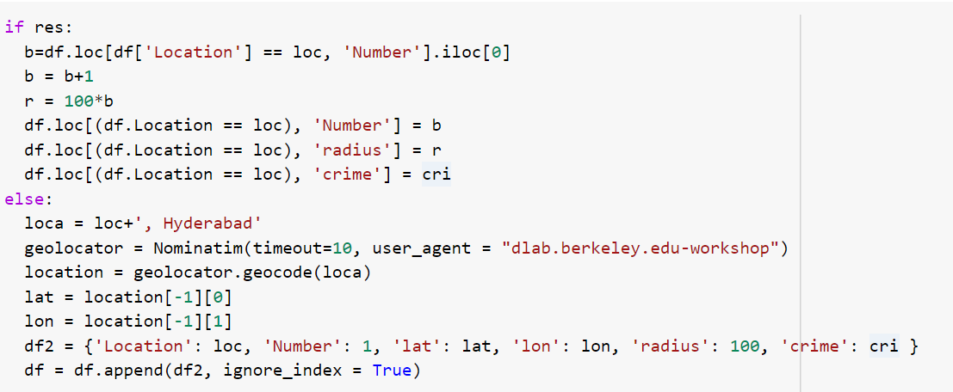
Function to add the location the dataset or create a new row if location does not exist

Slide 35
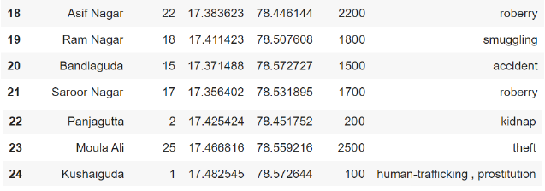
Screenshot after inserting input (1)

Slide 36
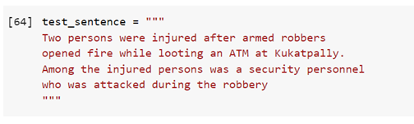
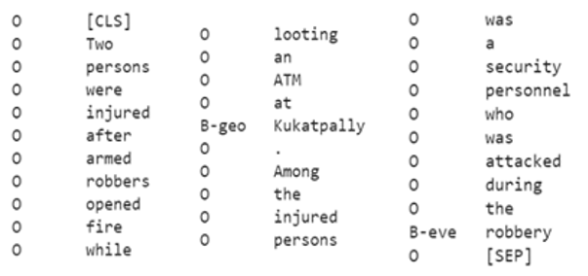
Input (2)
Output for input (2)

Slide 37
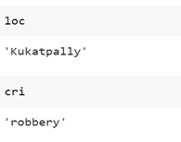
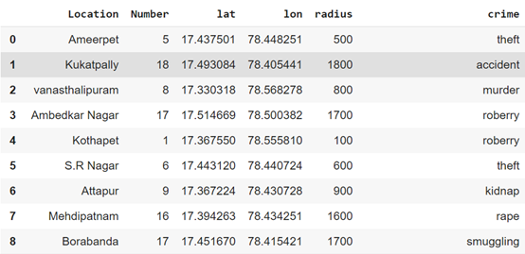
Processed output for input (2)
Screenshot before inserting input (2)

Slide 38
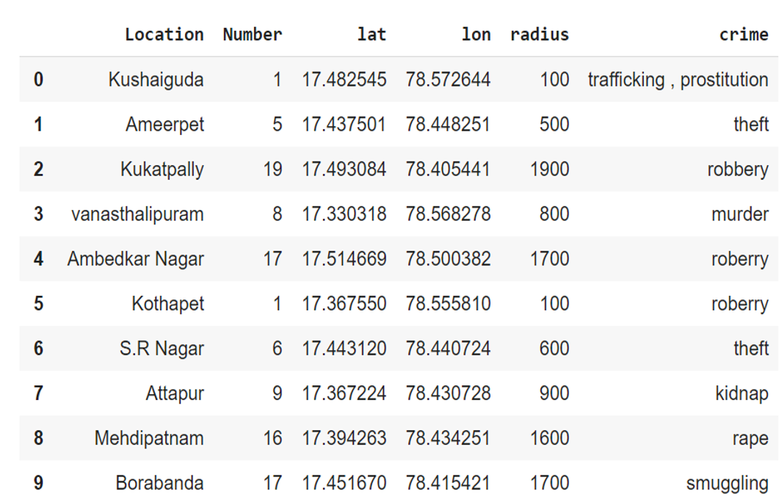
Screenshot after inserting input (2)

Slide 39
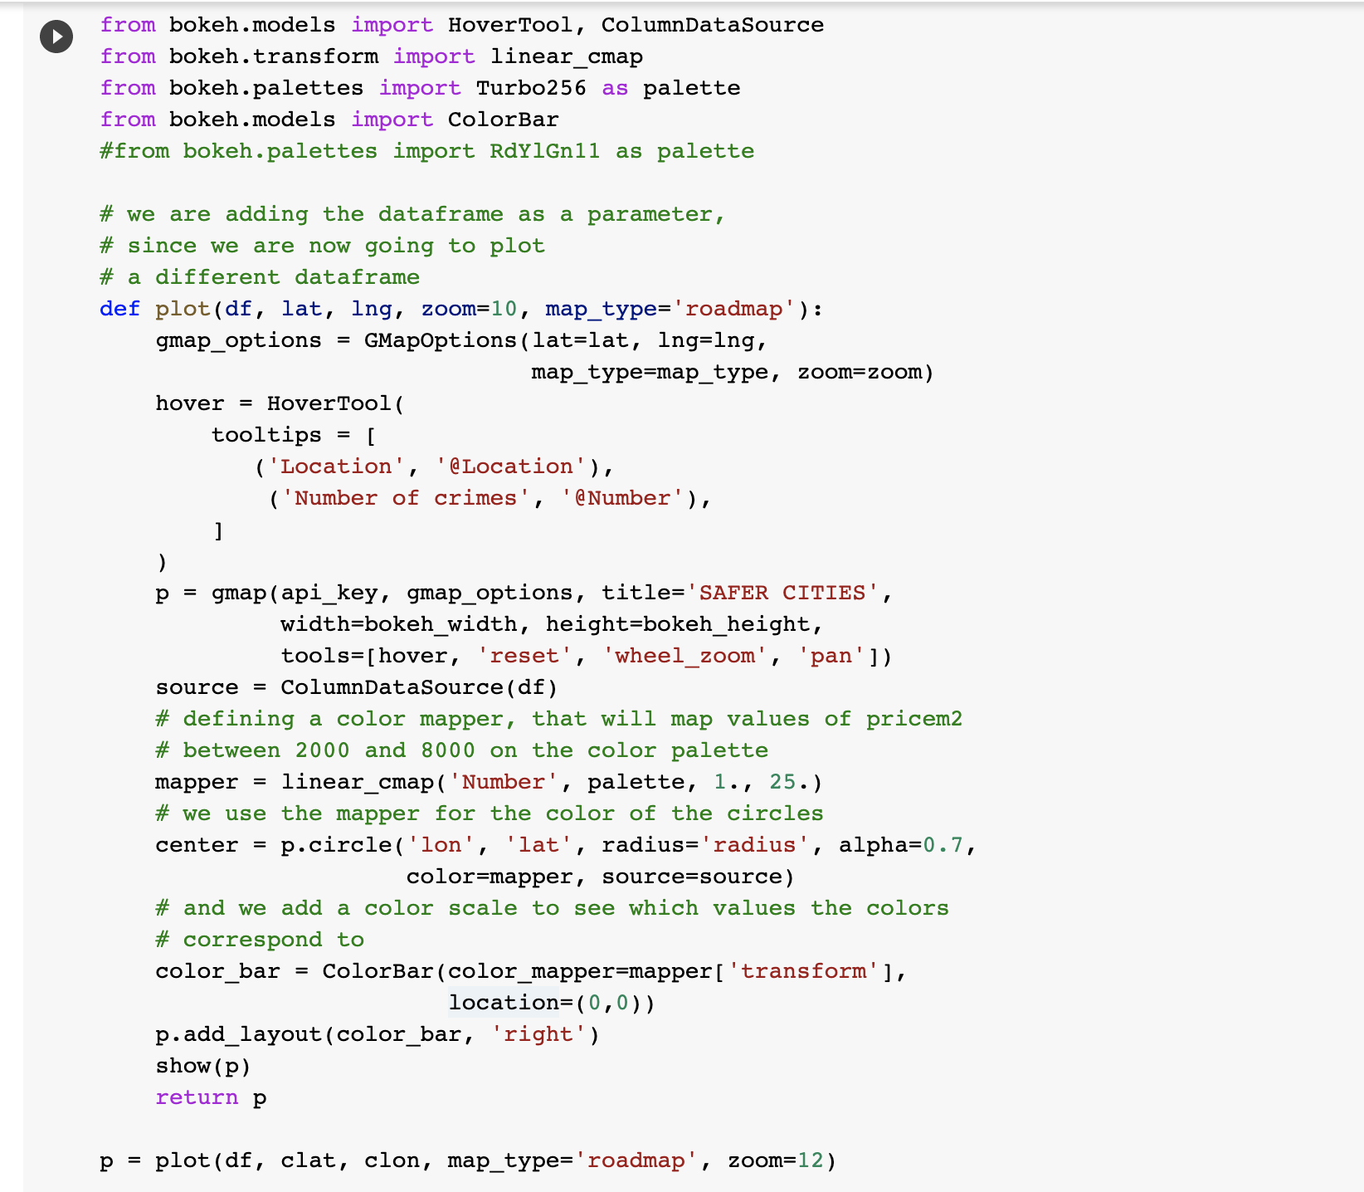
Function to plot the heat map using google map as background

Slide 40
Function to plot the heat map using google map as background

Slide 41
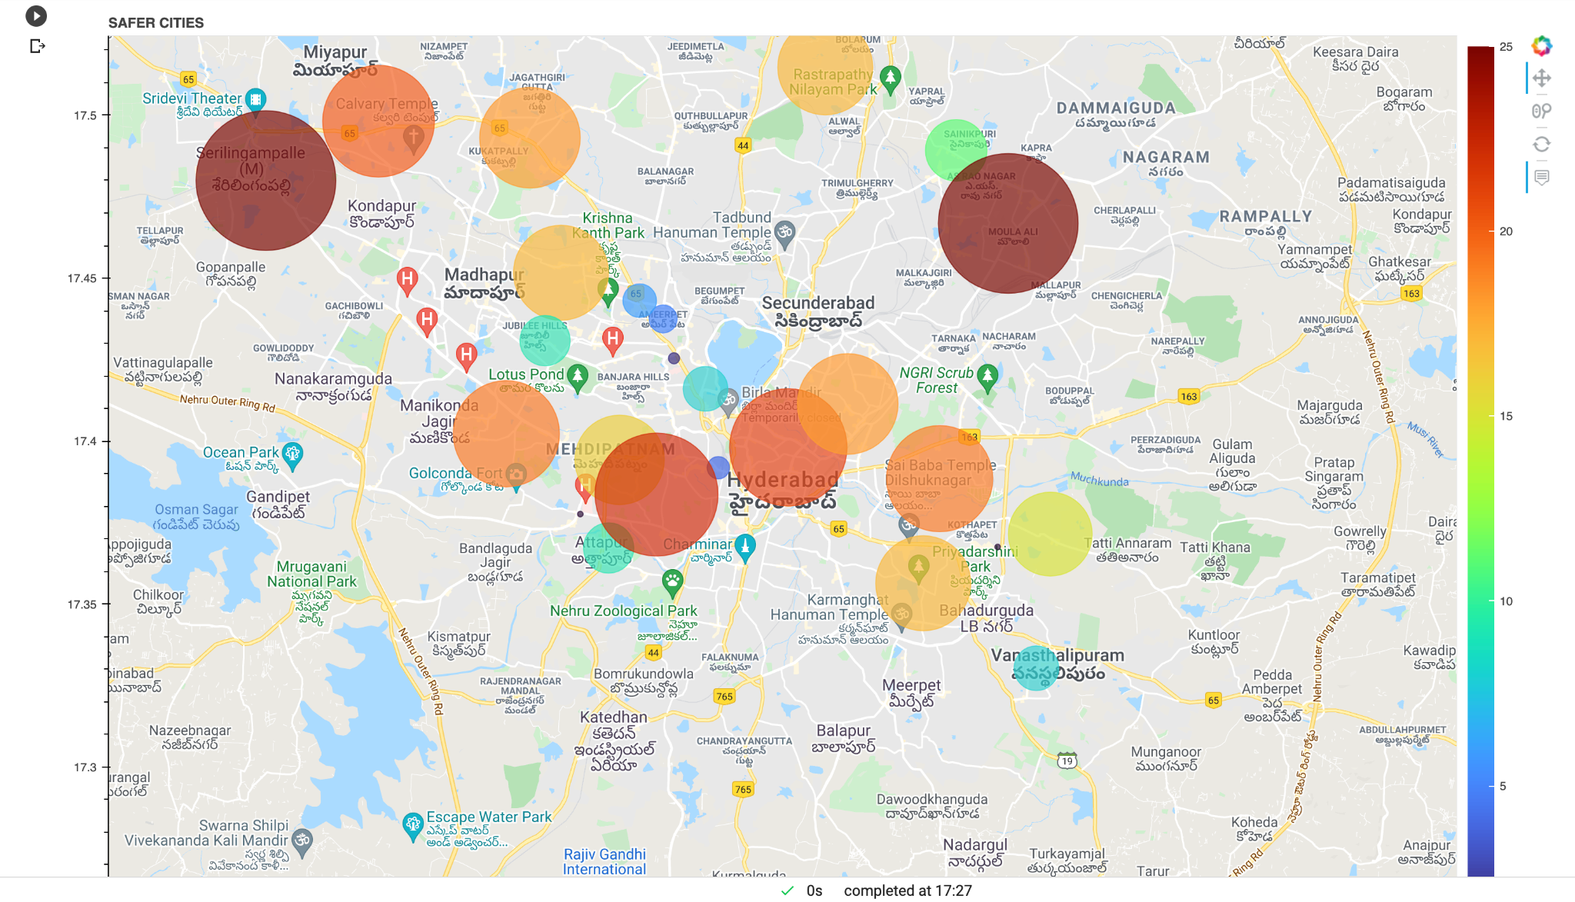
RESULTS

Slide 42
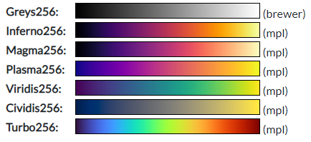
In the above slide the color bar on the right of the map is the palette used for the heat map.
The palette used is the Turbo256
The dark red on the top is used for the locations with the highest crime rate and dark blue at the bottom is used to denote the location with least crime rate on the heat map.
Bokeh palette options

Slide 43
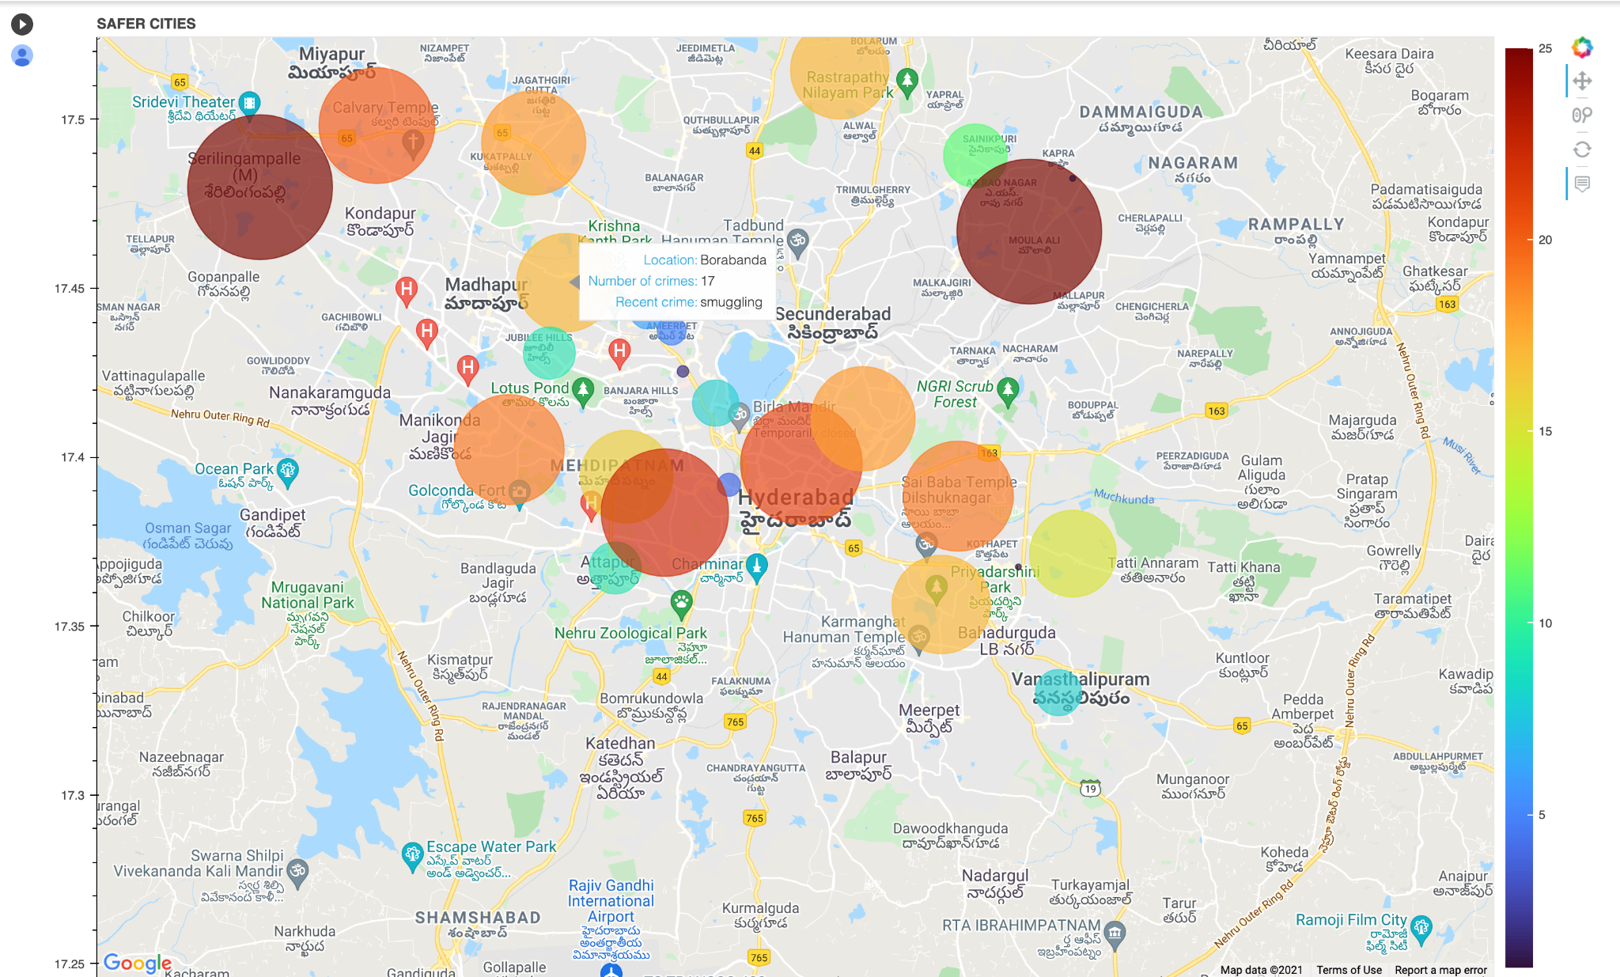
Haet map with the tooltip having the information about the location number of crimes and recent crime

Slide 44
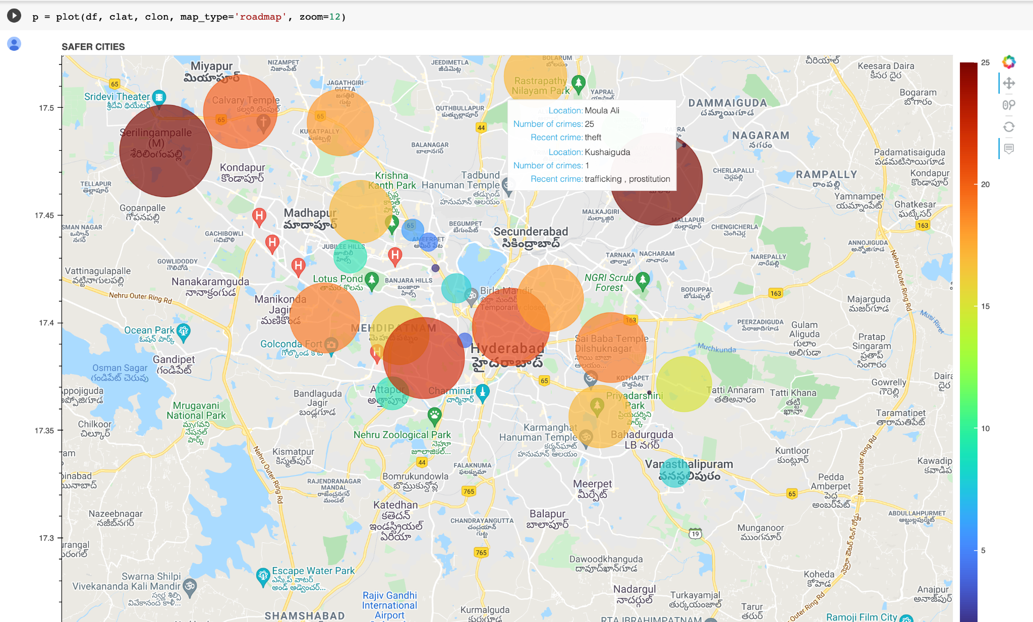
Haet map with the tooltip showing the intersection of two locations

Slide 45
CONCLUSION
We have built a model to process the sentences from news articles and recognise crime locations and crimes committed. After recognising the locations we have used a heatmap for easier understanding,
The accuracy of the model is 96.01% and f1-score is 83.73% which is a 3% increase from the model in the base paper.
FUTURE SCOPE
In the future we can extend the model by building a mobile app and incorporating database connectivity.

Slide 46
References
[1] Laura Po; Federica Rollo;“Building an Urban Theft Map by Analyzing Newspaper Crime Reports”,2018 13th International Workshop on Semantic and Social Media Adaptation and Personalization (SMAP);
[2] Mehedee Hassan; Mohammad Zahidur Rahman; “Crime news analysis: Location and story detection”; 2017 20th International Conference of Computer and Information Technology (ICCIT)
[3] Vignesh Rao; Jayant Sachdev; “A Machine learning Approach to classify Articles based on Location”; 2017 International Conference on Intelligent Sustainable Systems (ICISS)
[4] Alessandro Bondielli; Pietro Ducange; Francesco Marcelloni; “Location Exploiting Categorization of Online news for Profiling City Areas”; 2020 IEEE Conference on Evolving and Adaptive Intelligent Systems (EAIS)

Slide 47
THANK YOU

